Slide 1



CSS Styling Introduction
About the Course
CSS Styling
Telerik Software Academy
http://academy.telerik.com

Slide 2


Table of Contents
Course Objectives & Program
The Trainers
Evaluation
Learning Resources

Slide 3

Course Curriculum

Slide 4

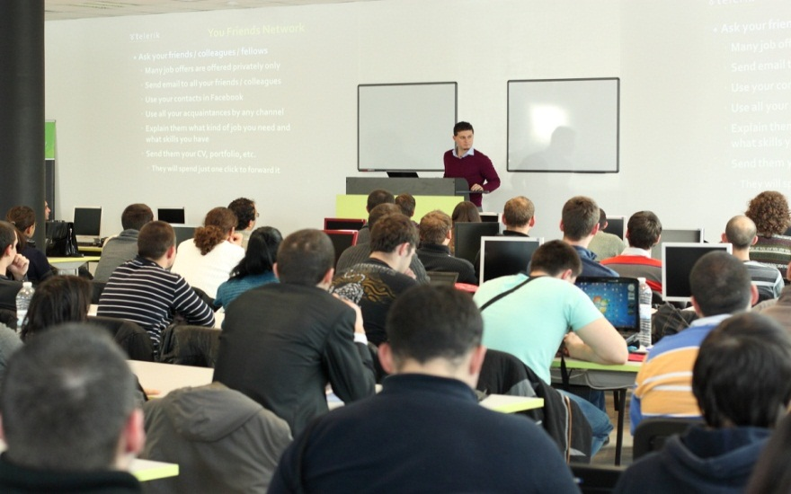
CSS Styling – Course Topics
CSS Overview
CSS Presentation
CSS Layout
Preprocessors (for CSS)
Exam Preparation
CSS Exam

Slide 5
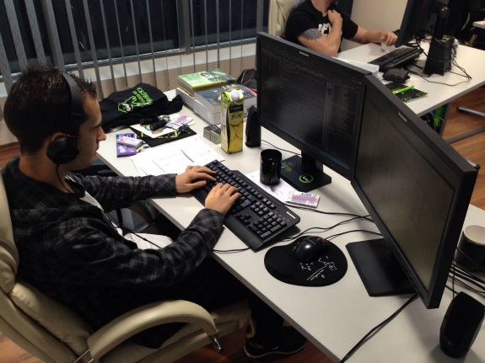
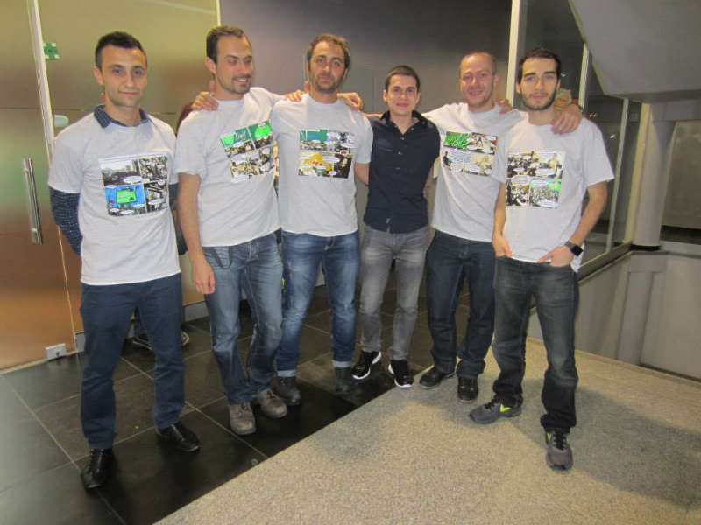
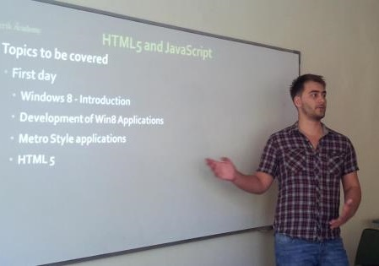
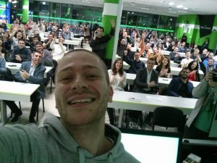
Trainers Team

Slide 6

Trainers Team
Nikolay Kostov
Manager Software Engineering @ Telerik (Progress)
Microsoft Certified Trainer (MCT)
Champion from Telerik Academy
IT and Informatics competitions winner
Student in Sofia University (Computer Science)
Email: nikolay.kostov [at] telerik.com
Blog: http://nikolay.it
GitHub: https://github.com/NikolayIT

Slide 7
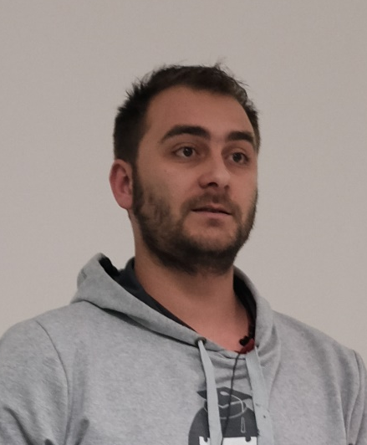
Trainers Team
Doncho Minkov
Senior Technical Trainer @ Telerik Software Academy
Contestant in the Informatics competitions
Champion from Telerik Software Academy
Experience with Web and Mobile apps
Proficient with JavaScript and .NET
Email: doncho.minkov [at] telerik.com
Blog: http://minkov.it
GitHub: https://github.com/Minkov

Slide 8
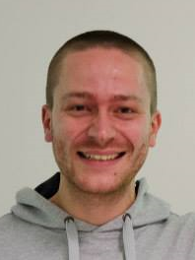
Trainers Team (3)
Ivaylo Kenov
Technical Trainer @ Telerik Academy
Mathematical competitions contestant
Champion from Telerik Software Academy
E-mail: ivaylo.kenov [at] telerik.com
Champion in OOP and DSA
Blog: http://ivaylo.bgcoder.com/
GitHub: https://github.com/ivaylokenov

Slide 9

Trainers Team (4)
Evlogi Hristov
Technical Trainer @ Telerik Software Academy
Graduate from the fourth season of Telerik Software Academy
Ex-developer, Sharepoint
E-mail: evlogi.hristov [at] telerik.com

Slide 10





Evaluation
Thank God There Are Bonuses!

Slide 11

CSS Styling - Evaluation
Evaluation components
Practical exam up to 70%
Attendance up to 10%
Homework up to 15%
Homework evaluation up to 5%
3 peer reviews per homework
Bonuses
Forums activity – bonus up to 5%

Slide 12
Homework Peer Reviews
Everyone will get feedback for their homework
Everyone will give feedback for few random homework submissions
Students submit homework anonymously
Please exclude your name from the submissions!
For each homework submitted
Students evaluate 3 random homeworks
From the same topic, after the deadline
Give written feedback, at least 200 characters
Low-quality feedback → report for punishment

Slide 13
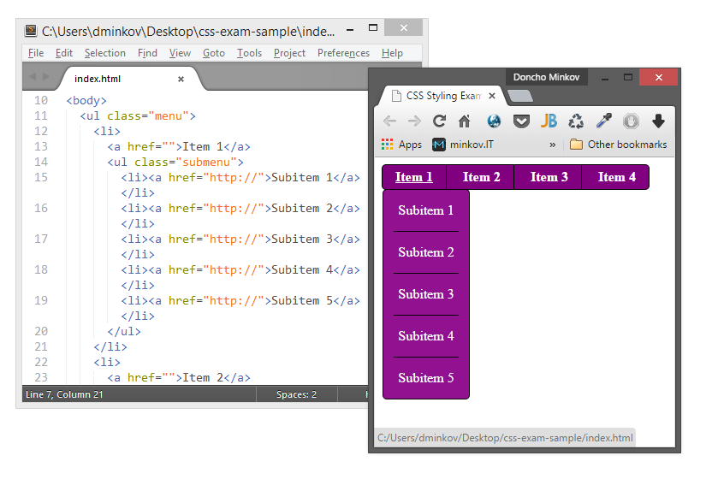
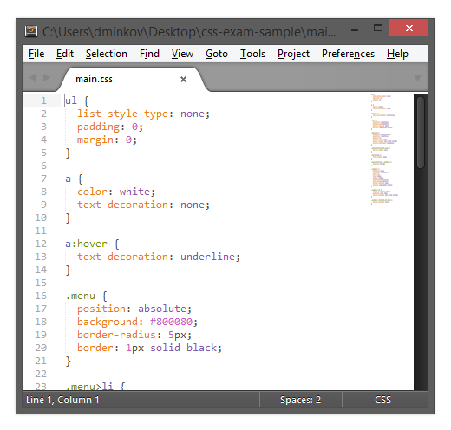
CSS Styling Exam
You are given HTML, JavaScript and images:
You must write the CSS to match the images:

Slide 14

Recommended Books

Slide 15


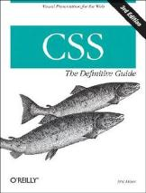
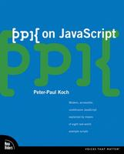
Recommended Books
“Designing with Web Standards”, Jeffrey Zeldman, New Riders Press, 2005, ISBN 9780321616951
"HTML & XHTML: The Definitive Guide, Sixth Edition", Chuck Musciano, Bill Kennedy, O'Reilly, 2006, ISBN 9780596527327
"CSS: The Definitive Guide, Third Edition", Eric Meyer, O'Reilly, 2006, ISBN 9780596527334
“PPK on JavaScript”, Peter Paul-Koch, New Riders Press, 2006, ISBN 9780321423306

Slide 16
Course Web Site & Forums
Register for the "Telerik Academy Forums":
Discuss the course exercises with your colleagues
Find solutions for the exercises
Share source code / discuss ideas
The CSS Styling official web site:
http://telerikacademy.com/Forum/Category/27/HTML-CSS
academy.telerik.com/student-courses/web-design-and-ui/css-styling

Slide 17
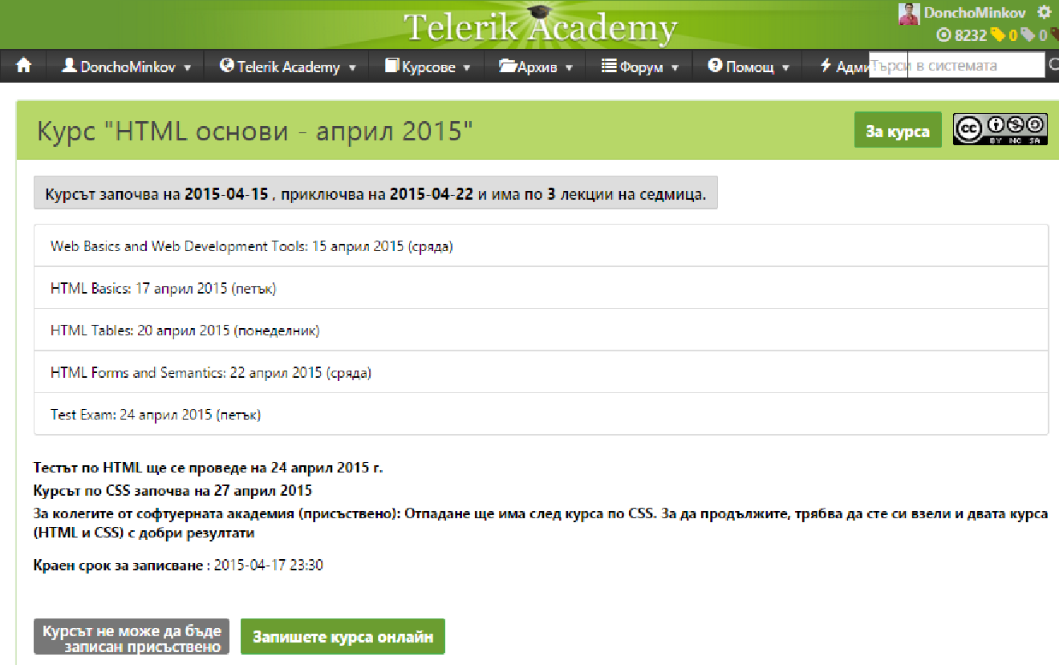
Telerik Integrated Learning System (TILS)
The Telerik Integrated Learning System (TILS)
www.telerikacademy.com
Important resource for all students
Homework submissions
Homework peer reviews
Presence cards with barcode
Reports about your results
telerikacademy.com/Courses/Courses/Details/231

Slide 18
Required Software
Software needed for this course:
Sublime Text 2/3
WebStorm 7
NotePad++
Jetbrains WebStorm
Aptana Studio
Microsoft Visual Studio *
Оr Visual Studio Express * (free versions of VS *)

Slide 19
CSS Styling: Course Introduction
http://academy.telerik.com

Slide 20



Free Trainings @ Telerik Academy
"Web Design with HTML5, CSS3 and JavaScript" course @ Telerik Academy
html5course.telerik.com
Telerik Software Academy
academy.telerik.com
Telerik Academy @ Facebook
facebook.com/TelerikAcademy
Telerik Software Academy Forums
forums.academy.telerik.com

